Slide 1
Intel Vectorization
Intel’s CPU SIMD instruction sets

Slide 2
The “Free Lunch” is over, really Processor clock rate growth halted around 2005
Increasing CPU frequency isn't practical.
Why?
Power , Heat
Higher frequency : cubic increase in power
Source: © 2014, James Reinders, Intel
Notes:
free lunch
​something you get free that you usually have to work or pay for

Slide 3
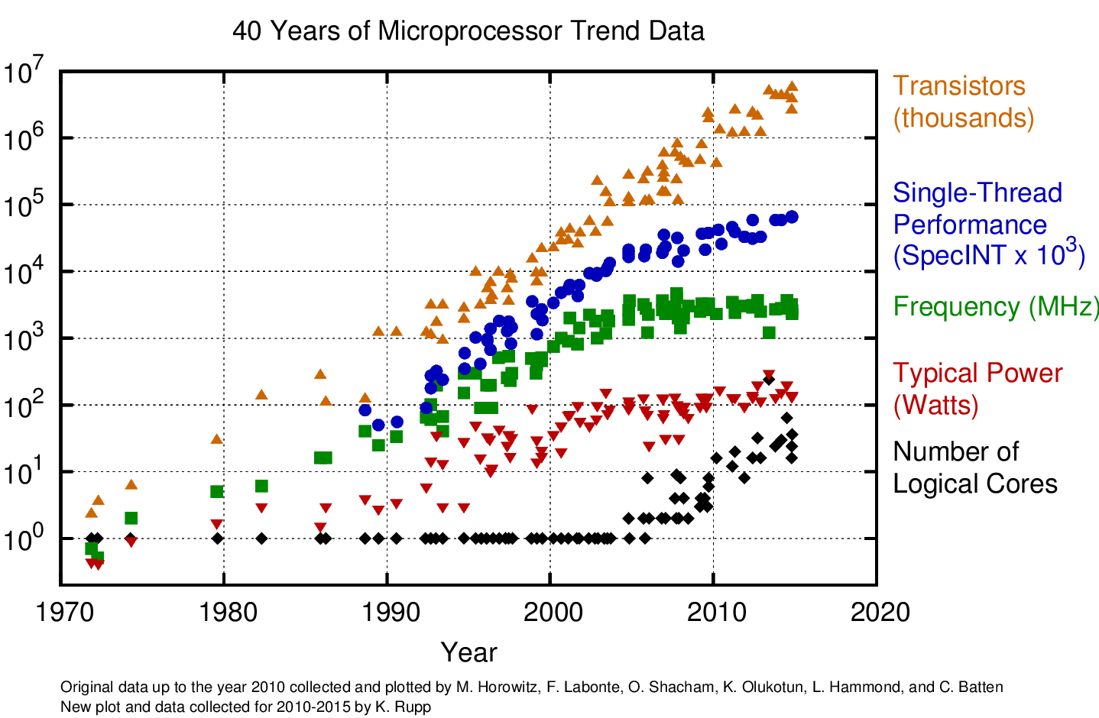
Moore’s Law Is STILL Going Strong Hardware performance potential continues to grow
“We think we can continue Moore's Law for at least another 10 years."
Intel Senior Fellow Mark Bohr, 2015
Today’s hardware speedup solutions
HyperThreading
Multicore
Vectorization
Linear increase in area and power
Notes:
Moore's Law is the observation made by Intel co-founder Gordon Moore that the number of transistors on a chip doubles every year while the costs are halved. In 1965, Gordon Moore noticed that the number of transistors per square inch on integrated circuits had doubled every year since their invention. Moore's law predicts that this trend will continue into the foreseeable future.
Although the recent pace has slowed for Moore's Law, the doubling of installed transistors on silicon chips occurs closer to every 18 months instead of annually. The 18-month mark is the current definition of Moore's law.

Slide 4
Untapped Potential Can Be Huge
High performance software must exploit both
High performance software must exploit both :
Threading parallelism
Vector parallelism

Slide 5
What is SIMD ? Single Instruction Multiple Data
SIMD Mode
Scalar Mode
128-bit width vector (4 × 32-bit float)
+
A[0] | A[1] | A[2] | A[3]
A(32 bit float)
+
SSE
ADD
Single Floating-
Point ADD
B[0] | B[1] | B[2] | B[3]
B(32 bit float)
C[0] | C[1] | C[2] | C[3]
C(32 bit float)
SIMD is 4 times faster ideally
SIMD instructions operate on multiple data elements in one instruction and make use of the 128-bit SIMD floating-point registers.

Slide 6
What is Vectorization?
The use of the Intel SSE(or AVX) instruction set, which is an extension to the x86 architecture, is called vectorization.
•Hardware Perspective: Specialized instructions, registers, or functional units to allow in-core parallelism for operations on arrays (vectors) of data.
•Compiler Perspective: Determine how and when it is possible to express computations in terms of vector instructions
•User Perspective: Determine how to write code in a manner that allows the compiler to deduce that vectorization is possible.
SSE: Streaming SIMD Extension , AVX = Advanced Vector Extension

Slide 7
Vectorization History
1996 MMX 64bit | 1999 SSE 128bit | 2000 SSE2 128bit | 2004 SSE3 128bit | 2006 SSSE3 128bit | 2007 SSE4.1 128bit | 2007 SSE4.1 128bit | 2011 AVX 256bit | 2013 AVX2 256bit | 2016 AVX512 512bit
MMX uses FP registers in x86 architecture for SIMD data, and has only integer SIMD
SSE introduce separate XMM registers with single precision vectors.(Pentium III)
SSE2 introduce double precision vectors.(Pentium 4)
SSE3 adding a handful of DSP-oriented mathematics instructions.
AVX extend SIMD registers to 256 bits and introduce 3-operand instruction. (Sandy Bridge processors and later )
AVX2 support Gather and fused multiply–add (FMA). (Haswell Processor and later)
AVX512 extend SIMD registers to 512 bits. Provide 32 register. It allows 4 operands(Knights Landing processor )
Notes:
SSE originally added eight new 128-bit registers known as XMM0 through XMM7. The AMD64 extensions from AMD (originally called x86-64) added a further eight registers XMM8 through XMM15, and this extension is duplicated in the Intel 64 architecture. There is also a new 32-bit control/status register, MXCSR. The registers XMM8 through XMM15 are accessible only in 64-bit operating mode.
SSE used only a single data type for XMM registers:
four 32-bit single-precision floating point numbers
SSE2 would later expand the usage of the XMM registers to include:
two 64-bit double-precision floating point numbers or
two 64-bit integers or
four 32-bit integers or
eight 16-bit short integers or
sixteen 8-bit bytes or characters.
Because these 128-bit registers are additional machine states that the operating system must preserve across task switches, they are disabled by default until the operating system explicitly enables them. This means that the OS must know how to use the FXSAVE and FXRSTOR instructions, which is the extended pair of instructions which can save all x86 and SSE register states all at once. This support was quickly added to all major IA-32 operating systems.
The first CPU to support SSE, the Pentium III, shared execution resources between SSE and the floating point unit (FPU).^{[1]} While a compiled application can interleave FPU and SSE instructions side-by-side, the Pentium III will not issue an FPU and an SSE instruction in the same clock cycle. This limitation reduces the effectiveness of pipelining, but the separate XMM registers do allow SIMD and scalar floating point operations to be mixed without the performance hit from explicit MMX/floating point mode switching.
SSE2, Willamette New Instructions (WNI), introduced with the Pentium 4, is a major enhancement to SSE. SSE2 adds two major features: double-precision (64-bit) floating point for all SSE operations, and MMX integer operations on 128-bit XMM registers. In the original SSE instruction set, conversion to and from integers placed the integer data in the 64-bit MMX registers. SSE2 enables the programmer to perform SIMD math on any data type (from 8-bit integer to 64-bit float) entirely with the XMM vector-register file, without the need to use the legacy MMX or FPU registers. It offers an orthogonal set of instructions for dealing with common data types.
SSE3, also called Prescott New Instructions (PNI), is an incremental upgrade to SSE2, adding a handful of DSP-oriented mathematics instructions and some process (thread) management instructions.
SSSE3, Merom New Instructions (MNI), is an upgrade to SSE3, adding 16 new instructions which include permuting the bytes in a word, multiplying 16-bit fixed-point numbers with correct rounding, and within-word accumulate instructions. SSSE3 is often mistaken for SSE4 as this term was used during the development of the Core microarchitecture.
SSE4, Penryn New Instructions (PNI), is another major enhancement, adding a dot product instruction, additional integer instructions, a popcnt instruction, and more.
XOP, FMA4 and CVT16 are new iterations announced by AMD in August 2007^{[2][3]} and revised in May 2009.^{[4]}
Advanced Vector Extensions (AVX), Gesher New Instructions (GNI), is an advanced version of SSE announced by Intel featuring a widened data path from 128 bits to 256 bits and 3-operand instructions (up from 2). Intel released processors in early 2011 with AVX support.^{[5]} AVX requires support from the operating system.
AVX2, also known as Haswell New Instructions (HNI), is an expansion of the AVX instruction set.
AVX-512 (3.1 and 3.2) are 512-bit extensions to the 256-bit Advanced Vector Extensions SIMD instructions for x86 instruction set architecture.
Fused multiply–add
A fused multiply–add (sometimes known as FMA or fmadd)^{[2]} is a floating-point multiply–add operation performed in one step, with a single rounding. That is, where an unfused multiply–add would compute the product b×c, round it to N significant bits, add the result to a, and round back to N significant bits, a fused multiply–add would compute the entire expression a+b×c to its full precision before rounding the final result down to N significant bits.

Slide 8
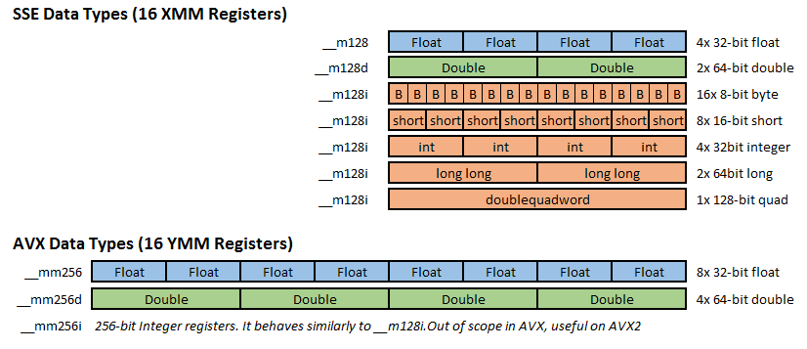
SSE & AVX registers
Notes:
SSE and AVX have 16 registers each. On SSE they are referenced as XMM0-XMM15, and on AVX they are called YMM0-YMM15. XMM registers are 128 bits long, whereas YMM are 256bit.
SSE adds three typedefs: __m128 , __m128d and __m128i. Float, double (d) and integer (i) respectively.
AVX adds three typedefs: __m256 , __m256d and __m256i. Float, double (d) and integer (i) respectively.
NOTE: XMM and YMM overlap! XMM registers are treated as the lower half of the corresponding YMM register. This can introduce some performance issues when mixing SSE and AVX code.
If you look at any SSE instruction table, you might notice that there are two basic types of operations:
Packed instructions (the assembly instruction ends with PS)
Scalar instructions (the assembly instruction ends with SS)
For most operations, there are two versions, one packed and one scalar.
What’s the difference between them? It’s pretty simple:
Scalar operations operate on only one element, for example a single integer.
Packed operations operate on any element in the vector in parallel, e.g. they multiply 4 32-bit integers in a single instruction.
SSE gains it performance from using packed operations implementing the SIMD paradigm (using a single instruction, multiple values are processed). However, it is occasionally useful to avoid expensive copying by using scalar operations operation on the SSE registers.

Slide 9
SSE & AVX registers
128 bit
SSE has 16 XMM register
XMM
256 bit
AVX has 16 YMM register
YMM
XMM
512 bit
ZMM
YMM
XMM
AVX512 has 32 ZMM register

Slide 10
Many Ways to Vectorize
Easy of Use
Use Performance Libraries (MKL ,IPP)
Implicit
Compiler : Auto Vectorization (no change of code)
Compiler : Auto Vectorization hints(#pragma vector)
Explicit
Explicit (user mandated) Vector Programming
OpenMP4.x, Intel CilkPlus (Array notation a[:] = b[:] + c[:])
SIMD intrinsic class
(e.g.: F32vec, F64vec, …)
Instruction aware
Vector intrinsic
(e.g.: _mm_fmadd_pd(…), _mm_add_ps(…), …)
Assembler code
(e.g.: [v]addps, [v]addss, …)
Programmer Control

Slide 11
Auto Vectorization

Slide 12
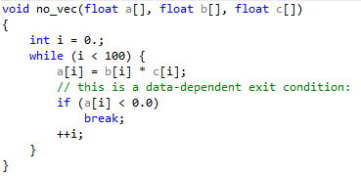
What sort of loops can be vectorized?
Countable the trip count can be a variable, but the variable must remain constant for the duration of the loop. This implies that exit from the loop must not be data-dependent.
Single entry and single exit
This is implied by countable

Slide 13
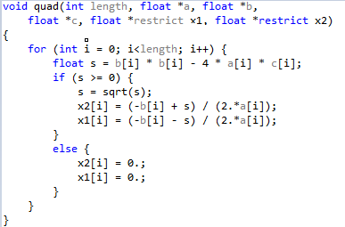
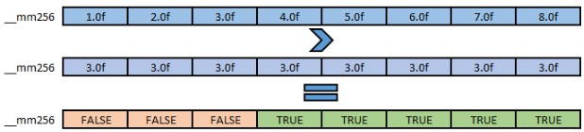
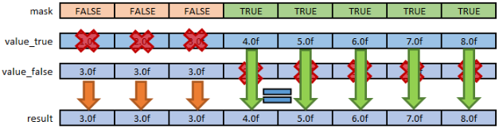
What sort of loops can be vectorized? Continue
Straight-line code Because SIMD instructions perform the same operation on data elements from multiple iterations of the original loop, it is not possible for different iterations to have different control flow.
thus branch and switch statements are banned.
LOOP WAS VECTORIZED
However, “if else” statements are allowed if they can be implemented as masked assignments
Notes:
Masked assignments : The calculation is performed for all data elements, but the result is stored only for those elements for which the mask evaluates to true.
https://www.codingame.com/playgrounds/283/sse-avx-vectorization/masking-and-condi
tional-load

Slide 14


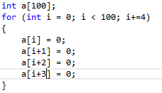

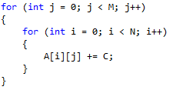
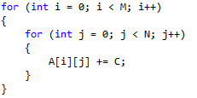
What sort of loops can be vectorized? Continue
The innermost loop of a nest By default, compilers attempt to vectorize innermost loops in nested loop structures
The only exception is if an original outer loop is transformed into an inner loop as a result of some other prior optimization phase, such as “loop unrolling”, “loop collapsing” or “loop interchange”.
Loop collapsing
Loop collapsing can improve the opportunities for other optimizations, such as loop unrolling.
Reduces loop overhead(branches).
If statements in loop are not dependent on each other, they can be executed in parallel.
Loop unrolling
improve the data memory access patterns and thus increase the overall code spatial locality.
Loop interchange
Notes:
Loop interchange (also known as iteration interleaving) changes the order of execution between two loops in a loop nest (see, e.g., [5]). The technique is useful to improve the data memory access patterns and thus increase the overall code spatial locality. Also, it can enable other important code transformations. Loop permutation (or loop reordering) is a generalization of this loop interchange transformation when more than two loops are reordered.
Temporal locality : related to Time
Spatial locality : related to Location. /ˈspeɪʃ(ə)l/

Slide 15
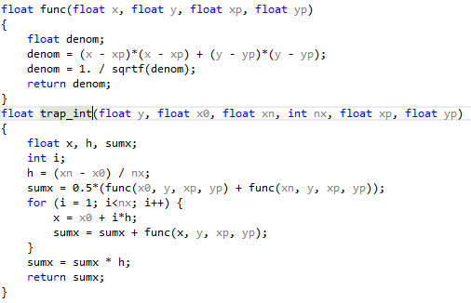
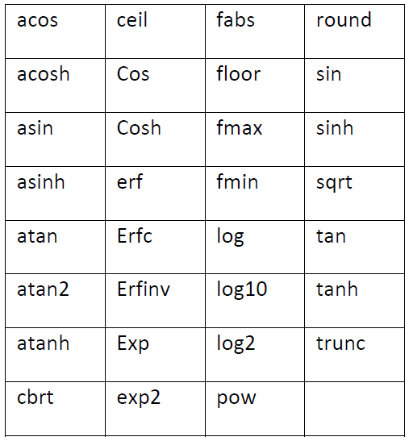
What sort of loops can be vectorized? Continue
No function calls Calling function inside loops make them unvectorizable.
But it has two exception :
Intrinsic math functions
Functions for which the compiler
has a vectorized version.
1.sqrtf() is vectorizable
LOOP WAS VECTORIZED
Inlined Functions
2.Inlining is enabled at default optimization for functions in the same source file.
Typical compiler message : “nonstandard loop is not a vectorization candidate”

Slide 16
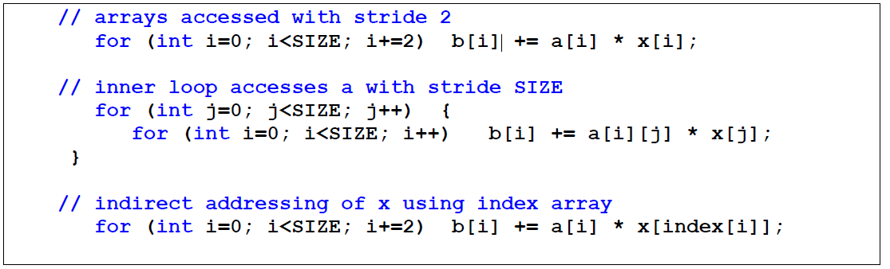
Obstacles to vectorization
1.Non-contiguous Memory Accesses
Lead to higher cache miss
The most common examples of non-contiguous memory access are :
loops with non-unit stride : access memory from non adjacent locations
Loops with indirect addressing
Typical compiler message : “vectorization possible but seems inefficient”
Typical compiler message : “Existence of vector dependence “
Loop interchange is helpful
The compiler rarely vectorizes such loops, unless the amount of computational work is large compared to the overhead from non-contiguous memory access.
Notes:
Obstacles to vectorization
The following do not always prevent vectorization, but frequently either prevent it or cause the compiler to decide that vectorization would not be worthwhile.

Slide 17
Obstacles to vectorization. Continue
2. Data dependencies
2.1 Read-After-Write(RAW) When a variable is written in one iteration and read in a subsequent iteration , also known as a Flow dependency or True dependency
Read R1,R2
Write R3
ADD R3,R2,R1
IF
ID
EX
MEM
WB
SUB R4,R3,1
IF
ID
EX
MEM
WB
Add R5,R4,5
IF
ID
EX
MEM
WB
Operand Forwarding can reduce impact of RAW
Read R3
Loop with Flow Dependency cannot be vectorized safely
Notes:
Reducing Impact of RAW Hazards: Data Forwarding
Sometime forwarding doesn’t work : load-use data hazard. In load instruction R4 register filled at MEM stage(so we need 1 cycle stall)
Register renaming is useful for eliminating Flow Dependency;

Slide 18
Obstacles to vectorization. Continue
2. Data dependencies
2.1 Read-After-Write(RAW) .Continue
What if the iterations run out of order?
Might read from a location before the correct value was written to it
What if the iterations do not run in lock-step?
Same problem!

Slide 19
Obstacles to vectorization. Continue
2. Data dependencies
2.2 Write-After-Read(WAR)
When a variable is read in one iteration and written in a subsequent iteration , also known as a
Anti-dependency
ADD R1,R2,R3
SUB R2,R4,R1
SUB R3,R4,R1
Problem : ADD could use wrong value for R2
Anti
Solutions :
1. Register renaming
2. Loop distribution
Notes:
This introduces write-after-read (WAR) hazards because the instruction that writes the data into a memory location has to wait until that memory location has been read by the previous instruction or else the reading instruction would read the wrong value.
Only flow dependency is true dependency and anti and output dependency are due to storage reuse and can be eliminated at the price of more memory usage
WAR and WAW hazards cannot occur because
• All instructions take 5 stages
• Reads happen in the 2nd stage (ID)
• Writes happen in the 5th stage (WB)
• No way for a write from a subsequent instruction to interfere with the read (or write) of a prior instruction
• For more complicated pipelines (later in the course) – Both WAR and WAW hazards are possible if instructions execute out of order or access (read) data later in the pipeline
Because of the natural structure of a pipeline, which typically reads values before it writes results, such hazards are rare. Pipelines for complex instruction sets that support auto increment addressing and require operands to be read late in the pipeline could create a WAR hazards.
With data forwarding (also called bypassing or short-circuiting), data is transferred back to earlier pipeline stages before it is written into the register file.
can’t happen in vanilla pipeline (reads in ID, writes in WB)
• can happen if: early writes (e.g., auto-increment) + late reads (??)
• can happen if: out-of-order reads (e.g., out-of-order execution)
With an in-order issue/in-order completion machine, we’re not as concerned with WAW, WAR

Slide 20
for (j=1; j<MAX; j++)
{
A[j-1]=A[j]+1;
}
This is not safe for general parallel execution.
But it is safe for vectorization because :
No iteration with a higher value of j can complete before an iteration with a lower value of j
Intel compiler can vectorize this loop successfully
for (j=1; j<MAX; j++)
{
A[j-1]=A[j]+1;
B[j]=A[j]*2;
}
When an iteration reads a location that a later iteration writes
may not be safe for vectorization because :
vectorization might cause some elements of A to be overwritten by the first SIMD instruction before being used for the second SIMD instruction
for (j=1; j<MAX; j++)
{
A[j-1]=A[j]+1;
}
for (j=1; j<MAX; j++)
{
B[j]=A[j]*2;
}
Loop distribution
Now This two loops are safe for vectorization.
Notes:
Both of this loops vectorized successfully in Intel compiler

Slide 21
Obstacles to vectorization. Continue
2. Data dependencies
2.3 Read-After-Read(RAR)
These situations aren’t really dependencies, and do not prevent vectorization or parallel execution
2.4 Write-After-Write(WAW)
the same variable is written to in more than one iteration, are in general unsafe for parallel execution, including vectorization. , also known as a Output-dependency
ADD R1,R2,R3
SUB R2,R4,R1
OR R1,R6,R3
OR R5,R6,R3
for( i=0; i<N; i++)
{
a[i%2] = b[i] + c[i];
}
Register
renaming
unvectorizable
(why is this a problem?)

Slide 22
Obstacles to vectorization. Continue
2. Data dependencies
2.5 Aliasing
Pointer aliasing is a hidden kind of data dependency that can occur in C, C++, or any other language that uses pointers
Memory regions of pointers may overlap.
At first glance, this appears a vectorizable loop with no apparent data dependencies.
Read-After-Write - UNVECTORIZABLE
1
void compute(double *a, double *b, double *c)
{
for (i=1; i<N; i++)
{
a[i] = b[i] + c[i];
}
}
3
for (i=1; i<N; i++)
{
p[i] = p[i-1] + q[i];
}
Programmer should assure the compiler that pointer arguments never refer to overlapping memory regions
Compiler Hint : restrict or
#pragma ivdep (Ignore Vector Dependencies)
2
compute(p, p+1, q);
Call method by p,p+1 ,q
4
void compute(double * restrict a, double * restrict b, double * restrict c)
{
…
}
Notes:
IVDEP (Ignore Vector DEPendencies)

Slide 23

Obstacles to vectorization. Continue
2. Data dependencies
2.6 Loop carried dependency
data dependence occurs between accesses across different loop iterations.
if the loop is removed, the dependence no longer exists
Loop-carried Dependence Graph (LDG)
0
1
2
3
N
S1:
Each node represent one iteration
arrows represent dependencies
S1[i] T S1[i+1]
This loop isn’t vectorizable
Generally If there is a loop carried dependence, then that loop cannot be parallelized
Notes:
Loop carried dependency = True dependency between loop iteration.
S1 ->T S2 A true dependence between S1 and S2 means that S1 writes to a location later read from by S2
S1 ->A S2 An anti-dependence between S1 and S2 means that S1 reads from a location later written to by S2.
S1 ->O S2 An output dependence between S1 and S2 means that S1 and S2 write to the same location.
S1 ->I S2 An input dependence between S1 and S2 means that S1 and S2 read from the same location.
DOACROSS parallelism & DOPIPE parallelism is useful for parallelize sequential loops.

Slide 24


Obstacles to vectorization. Continue
2. Data dependencies
Loop carried dependency example
S1[i] T S1[2*i]
S1:
Later iterations of i loop depend on earlier iterations
S1:
S1[i, j] T S1[i+1, j-2]
Later iterations of both i and j loops depend on earlier iterations

Slide 25

Obstacles to vectorization. Continue
2. Data dependencies
Loop carried dependency example
Dependences might only be carried over one loop!
0,4
1,4
2,4
3,4
4,4
0,3
1,3
2,3
3,3
4,3
S1:
0,2
1,2
2,2
3,2
4,2
Can parallelize i loop, but not j loop
0,1
1,1
2,1
3,1
4,1
0,0
1,0
2,0
3,0
4,0
S1[i, j] T S1[i, j+1]

Slide 26

Obstacles to vectorization. Continue
2. Data dependencies
Loop carried dependency example
Dependences might only be carried over one loop!
0,4
1,4
2,4
3,4
4,4
S1:
0,3
1,3
2,3
3,3
4,3
0,2
1,2
2,2
3,2
4,2
Can parallelize j loop, but not i loop
0,1
1,1
2,1
3,1
4,1
0,0
1,0
2,0
3,0
4,0
S1[i-1, j] T S1[i+1, j]

Slide 27

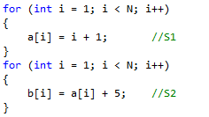
Obstacles to vectorization. Continue
2. Data dependencies
2.7 Loop Independent Dependence
data dependence exist within One loop iteration.
if the loop is removed, the dependence still exists
Loop distribution
S2 has a True dependency with S1
S1[i] T S2[i]

Slide 28
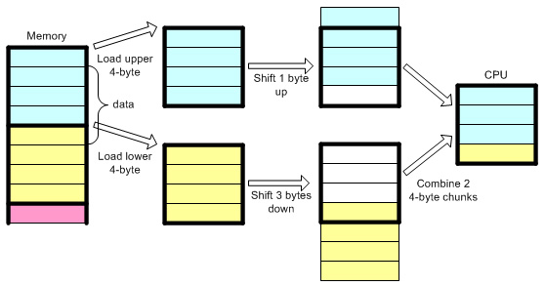
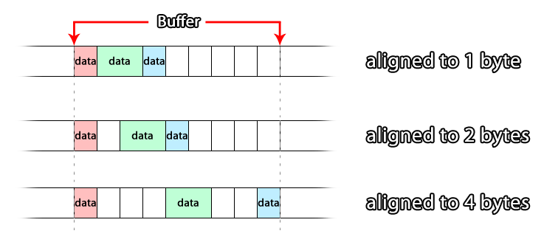
Alignment
Data alignment means putting the data in memory at address equal to some multiple of the WORD size.
A memory address ptr is said to be n-byte aligned when ptr is a multiple of n bytes (where n is a power of 2).

Slide 29
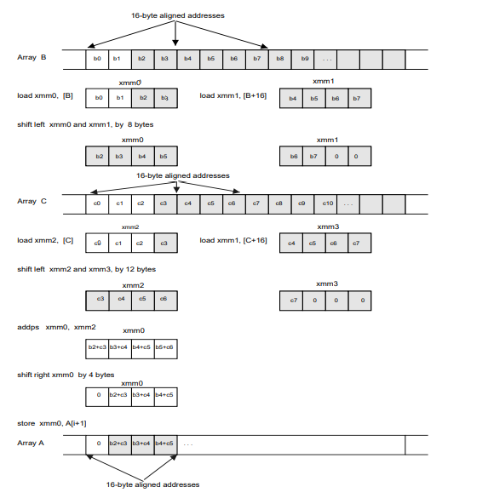
Alignment
misaligned accesses in SSE
a[i + 1] = b[i + 2] + c[i + 3]

Slide 30
Alignment
ARM
Load and store in older ARM processors work only on aligned addresses.
feeding unaligned memory to arm compiler leads to undefined operation .
AltiVec (SIMD instruction of PowerPC)
PowerPC belongs to Apple, IBM, Motorola alliance
Old version of AltiVec extension is unable to operate on data that is not naturally aligned.
Intel SSE
the Intel’s SSE extension support aligned and unaligned access and unaligned exceptions
MOVAPS - Move Aligned Packed Single-Precision
only work on aligned memory, otherwise throw an alignment-check exception (#AC) or
general-protection exception (#GP).
MOVUPS - Move Unaligned Packed Single-Precision
could work on unaligned memory.
Notes:
پاور پی‌سی در ابتدا برای کامپیوترهای شخصی طراحی شده بود و از سال ۱۹۹۴ تا ۲۰۰۶ −پیش از آن که اپل به پردازنده‌های اینتل روی آورد − در کامپیوترهای شخصی مکینتاش، محصول اپل استفاده می‌شد.

Slide 31
Alignment
Cache could reduce the unaligned access penalty
Cache line #1 64Byte
Cache line #2 64Byte
8 byte | 8 byte | 8 byte | 8 byte | 8 byte | 8 byte | 8 byte | 8 byte
8 byte | 8 byte | 8 byte | 8 byte | 8 byte | 8 byte | 8 byte | 8 byte
4 | 4
4 | 4
8 byte
8 byte
Overhead of this read is negligible
Read this 8 byte is out of cache line boundary and
leads to misaligned access overhead
Even when you read just one byte from the memory, CPU reads a complete cache line and places it into the cache.
This way reading 8 bytes from offset 5 or from offset 0 makes no difference .
CPU reads 64 bytes in any case.

Slide 32
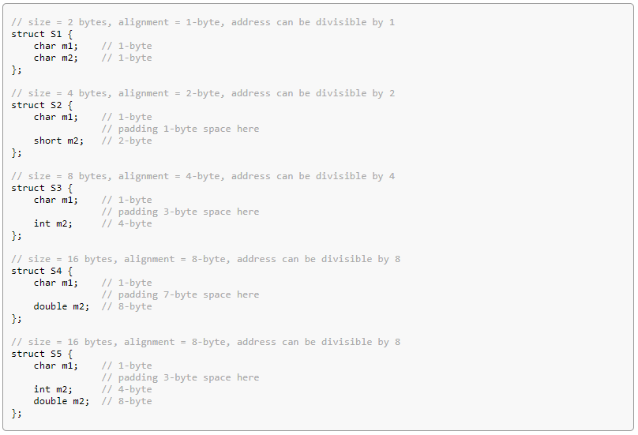
Alignment
Structure Member Alignment
The struct member variables must be aligned to the highest size of any member variables to prevent performance penalties.
Notes:
اینpadding باعث میشود خانه های حافظه ی member های struct در دو بلاک متفاوت قرار نگیرند. و cpu دیگر نیازی به اجرای عملیات های اضافه تری مثل Shift دادن برای استخراج مقدار هر متغیر نیست.

Slide 33
Alignment
unaligned memory access impacts
Unaligned loads and stores can be very slow due to higher I/O because two cache-lines need to be loaded/stored (not always, though)
Compiler can mitigate expensive unaligned memory operations by using two partial loads/stores –still slow(e.g. two 64 bit loads instead of one 128 bit unaligned load)
The compiler can use “versioning” in case alignment is unclear: Run time checks for alignment to use fast aligned operations if possible, the slower operations otherwise –better but limited

Slide 34
Alignment
Default alignment size
Architecture | MSVC | ICC
x86 | 8 byte | 8 byte
x64 | 16 byte | 16 byte
Best Performance
16 byte for SSE
32 byte for AVX
64 byte for AVX-512

Slide 35
Alignment
Manual Alignment
1. You can use __declspec(align(#)) when you define a struct, union, or class, or when you declare a variable.
__declspec(align(32)) struct Str1{ int a, b, c, d, e; };
2. You can force dynamic memory allocation to be aligned.
MSVC : _aligned_malloc , _aligned_free
ICC : _mm_malloc , _mm_free
Compiler directives can force compiler to assume correct alignment
#pragma vector aligned
#pragma vector unaligned
Compiler alignment assurance hint
__assume_aligned( ArrayName, AlignedSize)
Notes:
Icc : intel c++ compiler

Slide 36
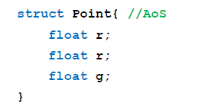
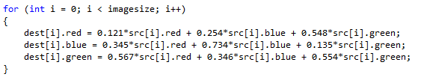
Prefer Structure of Arrays (SoA) over Array of Structures (AoS)
While AOS organization is excellent for encapsulation it can be poor for use of vector processing.
AOS
Not very SIMD-friendly
Below example use 75% of vector length in best situation
Good locality. cache friendly.
AOS memory pattern
r | g | b | r | g | b | r | g | b
AOS vector pattern
r | g | b
Read contiguous memory
vector length has been wasted
r | g | b
Notes:
خوبی این روش مجاور بودن خانه های یک struct در کنار هم هست. پس برای استفاده از این مزیت باید این اعضای کنار هم با هم درون vector های CPU بارگذاری شوند. اگر بخواهیم مثل SOA ، rها را با هم دریک vectorو gها و bها را در vector های جداگانه قرار دهیم به دلیل نامجاور بودن مثلا rها و load خانه های نامجاور در یک vector دیگر این روش هیچ مزیتی ندارد.
پس در بهترین حالت vector ها این شکلی میشوند. RGBX که X خانه خالی است
AOS structures require gathers and scatters, which can impact both SIMD efficiency as well as introduce extra bandwidth and latency for memory accesses. The presence of a hardware gather-scatter mechanism does not eliminate the need for this transformation - gather-scatter accesses commonly need significantly higher bandwidth and latency than contiguous loads.

Slide 37
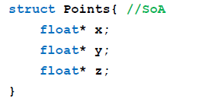
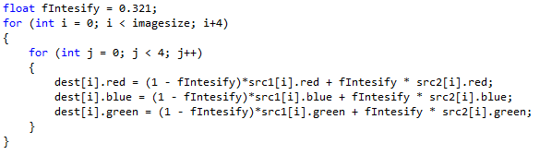
Prefer Structure of Arrays (SoA) over Array of Structures (AoS)
SOA
SIMD-friendly. can utilize all vector length
Poor locality. Poor cache efficiency.
Use hybrid method to overcome this problem (AoSoA)
SOA memory pattern
r | r | r | r | r | r | r | r | r | r | r | r
g | g | g | g | g | g | g | g | g | g | g | g
b | b | b | b | b | b | b | b | b | b | b | b
r | r | r | r
g | g | g | g
b | b | b | b
SOA vector pattern
Read non-contiguous memory
All vector length utilize
Notes:
SOA: A common optimization that helps prevent gathers and scatters in vectorized code

Slide 38
AOSOA
SIMD-friendly. can utilize all vector length
Good locality. cache friendly.
AOSOA memory pattern
r | r | r | r | g | g | g | g | b | b | b | b
r | r | r | r | g | g | g | g | b | b | b | b
r | r | r | r | g | g | g | g | b | b | b | b
r | r | r | r
g | g | g | g
b | b | b | b
Read contiguous memory
All vector length utilize
AOSOA vector pattern
Notes:
The idea here is to get the benefit of locality at the outer-level and also unit-stride at the innermost-level.

Slide 39
Vectorization Guidelines for Data Structures
Use the smallest data types that give the needed precision, to maximize potential SIMD width.
Avoid mixing vectorizable data types in the same loop (except for integer arithmetic on array subscripts).
Avoid operations not supported in SIMD hardware. (like remainder operator “%” )
Use all the instruction sets available for your processor.(SSE4.1, SSE4.2, AVX, etc. )
Force vectorization regardless of the outcome of the compiler efficiency analysis.(#pragma vector always)
Notes:
5.4 Vectorization Guidelines for Data Structures
• Use the smallest data types that give the needed precision, to maximize potential SIMD width. (If only 16-bits are needed, using a short rather than an int can make the difference between eight-way or four-way SIMD parallelism, respectively.)
• Avoid mixing vectorizable data types in the same loop (except for integer arithmetic on array subscripts). Vectorization of type conversions may be either unsupported or inefficient. The latest compilers, including the version 12 of the Intel® C++ Compilers for Windows* and Linux*, have greatly improved and can auto-vectorize mixed type loops. But avoid if possible. The example below illustrates the mixing of data types, which may prevent auto-vectorization.
void mixed(float *restrict a, double *restrict b, float *c)
{
for(int i = 1; i < 1000; ++i)
{
b[i] = b[i] - c[i];
a[i] = a[i] + b[i];
}
}
• Avoid operations not supported in SIMD hardware. Arithmetic with (80 bit) long doubles on Linux, and the remainder operator “%” are examples of operations not supported in SIMD hardware.
• Use all the instruction sets available for your processor. Use the appropriate command line option for your processor type, or select the appropriate IDE option under “Project / Properties / C/C++ / Code Generation / Intel Processor-Specific Optimization” (/QxSSE4.1, /QxSSE4.2, etc., on Windows*) and (-xSSE4.1, -xSSE4.2, etc, on Linux* or Mac OS* X), if your application will run only on Intel processors, or “Project / Properties / C/C++ / Code Generation / Enable Enhanced Instruction Set” (/arch:SSE2, /arch:SSE3 on Windows) and (-msse2, -msse3 on Linux or Mac OS X), if your application may run on compatible, non-Intel processors. If your application will run only on the processor type on which it was built, you may simply choose the command line option /QxHost (Windows) or –xhost (Linux or Mac OS X), or in the IDE, select “Project / Properties / C/C++ / Code Generation / Intel Processor-Specific Optimization / The processor performing the compilation (/QxHost)”. This option is available for both Intel® and non-Intel microprocessors but it may perform more optimizations for Intel microprocessors than it performs for non-Intel microprocessors. For more details about the available processor-specific options, see the article at http://software.intel.com/en-us/articles/performance-tools-for-software-developers-intel-compiler-options-for-sse-generation-and-processor-specific-optimizations/
• Vectorizing compilers usually have some built-in efficiency heuristics to decide whether vectorization is likely to improve performance. The Intel® C/C++ Compiler will disable vectorization of loops with many unaligned or non-unit stride data access patterns. However, if experimentation reveals that vectorization will still improve performance, the programmer can override this behaviour with a “#pragma vector always” hint before the loop, which asks the compiler to vectorize any loop regardless of the outcome of the efficiency analysis (provided, of course, that vectorization is safe).

Slide 40
Vectorization Reports
The Intel® Compiler provides a vectorization report option that provides two important kinds of information :
Inform you which loops in your code are being vectorized.
Report information about why the compiler did NOT vectorize a loop
Vectorization report has different level of information :
n=0: No diagnostic information
n=1: Loops successfully vectorized
n=2: Loops not vectorized - and the reason why not
n=3: Adds dependency Information
n=4: Reports only non-vectorized loops
n=5: Reports only non-vectorized loops and adds dependency info
How enable vectorization report? :
Microsoft Visual Studio IDE - Project Properties \ C/C++ \ Diagnostics \ Optimization Diagnostic Level \ choose from n0:n5
Or use /Qopt-report:<n> option

Slide 41
Examples of Vectorization Report Messages
Low trip count The loop does not have sufficient iterations for vectorization to be worthwhile
Not Inner Loop Only the inner loop of a loop nest may be vectorized.
Existence of vector dependence The compiler find a proven or potential dependence. you could ignore it by #pragma ivdep.
vectorization possible but seems inefficient The compiler thinks that vectorization may not improve the performance of this loop. You may use #pragma vector always to ask the compiler to vectorize it anyway.
Condition may protect exception When a loop containing an IF statement, compiler typically evaluates the RHS expressions for all values of the loop index, but only makes the final assignment in those cases where the conditional evaluates to TRUE. In some cases, the compiler may not vectorize out of concern that the condition may be protecting against accessing an illegal memory address.
An IVDEP pragma may be used to reassure the compiler that the conditional is not protecting against a memory exception in such cases.
Notes:
“Low trip count”: The loop does not have sufficient iterations for vectorization to be worthwhile
“Not Inner Loop”: Only the inner loop of a loop nest may be vectorized.
“Existence of vector dependence”: The compiler did not vectorize the loop because of a proven or potential dependence. If you are sure that any potential dependencies are not in fact realized, you may invite the compiler to ignore them with #pragma ivdep.
"vectorization possible but seems inefficient": The compiler thinks that vectorization may not improve the performance of this loop. You may use #pragma vector always to override the compiler’s performance assessment, and ask the compiler to vectorize anyway if it is safe to do so.
“Condition may protect exception”: When the compiler tries to vectorize a loop containing an IF statement, it typically evaluates the RHS expressions for all values of the loop index, but only makes the final assignment in those cases where the conditional evaluates to TRUE. In some cases, the compiler may not vectorize out of concern that the condition may be protecting against accessing an illegal memory address.
An IVDEP pragma may be used to reassure the compiler that the conditional is not protecting against a memory exception in such cases.
void test(int *a, int *restrict b) {
int i;
b[1] = 0;
#ifdef IVDEP
#pragma ivdep
#endif
for (i = 0; i < 100; i++) {
if ( a[i] == 20)
b[1] = i;
}
}

Slide 42
Examples of Vectorization Report Messages
data type unsupported on given target architecture For example, this message might occur when compiling a loop containing complex arithmetic for a target processor that supported only the SSE2 instruction set. SSE3 instructions are needed for effective vectorization of arithmetic involving complex data types.
Statement cannot be vectorized Certain statements, such as switch statements, can’t be vectorized.
Subscript too complex An array subscript may be too complicated for the compiler to decipher the memory access pattern. Try to write subscripts as an explicit function of the main loop counter.
Unsupported Loop Structure, Top test could not be found Loops that don’t fulfill the requirements of countability, single entry and exit, etc., may generate these messages.
Operator unsuited for vectorization Certain operators, such as the “%” (modulus) operator, can’t be vectorized.
Notes:
“data type unsupported on given target architecture”: For example, this message might occur when compiling a loop containing complex arithmetic for a target processor that supported only the SSE2 instruction set. SSE3 instructions are needed for effective vectorization of arithmetic involving complex data types.
“Statement cannot be vectorized”: Certain statements, such as switch statements, can’t be vectorized.
“Subscript too complex”: An array subscript may be too complicated for the compiler to decipher the memory access pattern. Try to write subscripts as an explicit function of the main loop counter.
“Unsupported Loop Structure”, “Top test could not be found”: Loops that don’t fulfill the requirements of countability, single entry and exit, etc., may generate these messages.
“Operator unsuited for vectorization”: Certain operators, such as the “%” (modulus) operator, can’t be vectorized.

Slide 43
Vectorization Code Generation
“I’ve stopped using the Intel Compiler.
Each time I ship the product to a customer, they complain that applications crashes !
What might be the issue?
How can it be overcome?

Slide 44
Multipath Auto-vectorization
CPU ID
Default
Path /arch /Qx
Additional paths /Qax
Specialized
Path /Qax
SSE2
SSE4.2
AVX
AVX2

Slide 45
Code Generation Option
Linux -x , Windows /Qx
Tells the compiler which processor features it may target, including which instruction sets and optimizations it may generate. Example : /QxSSE4.1
Linux -ax , Windows /Qax
Tells the compiler to generate multiple, feature-specific auto-dispatch code paths for Intel® processors if there is a performance benefit. Example : /QaxAVX
Linux -m , Windows /arch
This option tells the compiler which instruction sets it may generate. Code generated with these options should execute on any compatible, non-Intel processor with support for the corresponding instruction set.
Example : /arch:CORE-AVX2
Linux -xHost , Windows /QxHost
Tells the compiler to generate instructions for the highest instruction set available on the compilation host processor.

Slide 46
Code Generation Option
The -x and /Qx options enable additional optimizations not enabled with options -m or /arch (nor with options -ax and /Qax).
If you specify both the /Qax and /Qx options, the baseline code will only execute on Intel® processors compatible with the setting specified for the /Qx.
Options /arch(-m) and /Qx(-x) are mutually exclusive. If both are specified, the compiler uses the last one specified and generates a warning.
If you specify both the /Qax and /arch options, the compiler will not generate Intel-specific instructions.
More detail : https://software.intel.com/en-us/cpp-compiler-developer-guide-and-reference-code-generation-options

Slide 47
Intel Compiler Hint
#pragma ivdep ignore vector dependency
#pragma vector always ignore compile heuristics and always vectorize a loop
#pragma vector aligned ignore compile heuristics and vectorize
loop by aligned load\store operation
#pragma vector unaligned ignore compile heuristics and vectorize loop by
unaligned load\store operation
#pragma vector Nontemporal ignore compile heuristics and vectorize loop by streaming store.
#pragma novector do not vectorize.
#pragma loop count(n) typical iteration loop count, affect pipelining, vectorization
and other loop transformation.
#pragma unroll(n) suggest loop unroll factor
#pragma distribute point advise where to split a loop. All carried dependencies will be ignored.
#pragma prefetch hint to prefetch data.

Slide 48
Intel vector intrinsics

Slide 49
The Intel intrinsics Header file
MMX <mmintrin.h>
SSE <xmmintrin.h>
SSE2 <emmintrin.h>
SSE3 <pmmintrin.h>
SSSE3 <tmmintrin.h>
SSE4.1 <smmintrin.h>
SSE4.2 <nmmintrin.h>
AES <wmmintrin.h>
AVX <immintrin.h>
AVX512 <immintrin.h>

Slide 50
The Intel intrinsics Data Types
We will use the following data types:
__m128 packed single precision (vector XMM register)
__m128d packed double precision (vector XMM register)
__m128i packed integer (vector XMM register)
__m256 packed single precision (vector YMM register)
__m256d packed double precision (vector YMM register)
__m256i packed integer (vector YMM register)
__m512 packed single precision (vector ZMM register)
__m512d packed double precision (vector ZMM register)
__m512i packed integer (vector ZMM register)

Slide 51
The Intel intrinsics instruction
Intrinsics format: _prefix_instruction_suffix(…)
prefix can take many forms. Among them:
mm SSE
mm256 AVX,AVX2
mm512 AVX512
Suffix can take many forms. Among them:
ss scalar single precision
ps packed (vector) single precision
sd scalar double precision
pd packed double precision
si# scalar integer (8, 16, 32, 64, 128 bits)
su# scalar unsigned integer (8, 16, 32, 64, 128 bits)
Instructions list and description :
https://software.intel.com/sites/landingpage/IntrinsicsGuide/

Slide 52
The Intel intrinsics instruction
Packed
vs
Scalar
mulps XMM1 , XMM2
mulss XMM1 , XMM2
127
95
63
31
0
127
95
63
31
0
XMM1
4 | 3 | 2 | 1
XMM1
4 | 3 | 2 | 1
×
×
×
×
×
XMM2
4 | 3 | 2 | 12
XMM2
4 | 3 | 2 | 12
=
=
=
=
=
XMM1
16 | 9 | 4 | 12
XMM1
4 | 3 | 2 | 12

Slide 53
The Intel intrinsics instruction - example
Load four 16-byte aligned single precision values in a vector:
float a[4]={1.0,2.0,3.0,4.0};//a must be 16-byte aligned
__m128 x = _mm_load_ps(a);
Add two vectors containing four single precision values:
__m128 a, b;
__m128 c = _mm_add_ps(a, b);

Slide 54
The Intel intrinsics instruction - example
#define n 1024
__attribute__ ((aligned(16))) float a[n], b[n], c[n];
intmain()
{
for (i = 0; i < n; i++)
{
c[i]=a[i]*b[i];
}
}
SSE intrinsic equivalent
#include <xmmintrin.h>
#define n 1024
__attribute__((aligned(16))) float a[n], b[n], c[n];
intmain()
{
__m128 rA, rB, rC;
for (i = 0; i < n; i+=4)
{
rA= _mm_load_ps(&a[i]);
rB= _mm_load_ps(&b[i]);
rC= _mm_mul_ps(rA, rB);
_mm_store_ps(&c[i], rC);
}
}

Slide 55
Load intrinsics
float* ptr
SrcVec
Memory stream
10.2 | 15.0 | 21.2 | 25.3 | 0.1 | 4.0 | 45.3 | 68.3 | 15.2 | 47.1
11 | 12 | 9 | 8
__m128 DstVec = _mm_load_ps(ptr);
DstVec :
10.2 | 15.0 | 21.2 | 25.3
__m128 DstVec = _mm_load_ps1(ptr);
DstVec :
10.2 | 10.2 | 10.2 | 10.2
__m128 DstVec = _mm_load1_ps(ptr);
DstVec :
10.2 | 10.2 | 10.2 | 10.2
__m128 DstVec = _mm_load_ss(ptr);
DstVec :
10.2 | 0 | 0 | 0
__m128 DstVec = _mm_load_ss(ptr);
DstVec :
10.2 | 0 | 0 | 0
__m128 DstVec = _mm_loadr_ps(ptr);
DstVec :
25.3 | 21.2 | 15.0 | 10.2
r = reverse
__m128 DstVec = _mm_loadu_ps(ptr);
DstVec :
10.2 | 15.0 | 21.2 | 25.3
Don’t need aligned memory
U = unaligned
__m128 DstVec = _mm_loadh_pi( SrcVec, ptr);
DstVec :
11 | 12 | 10.2 | 15.0
h = load high elements
__m128 DstVec = _mm_loadl_pi( SrcVec, ptr);
DstVec :
10.2 | 15.0 | 9 | 8
l = load low elements

Slide 56
Load intrinsics
float* ptr
Memory stream
10.2 | 15.0 | 21.2 | 25.3 | 0.1 | 4.0 | 45.3 | 68.3 | 15.2 | 47.1
__m128i _mm_stream_load_si128 (__m128i * mem_addr)
Load 128-bits of integer data from memory into destination using a non-temporal memory hint.
__m256 _mm256_broadcast_ps (__m128 const * ptr)
DstVec :
10.2 | 15.0 | 21.2 | 25.3 | 10.2 | 15.0 | 21.2 | 25.3
__m256 _mm_broadcast_ss (float const * ptr)
DstVec :
10.2 | 10.2 | 10.2 | 10.2 | 10.2 | 10.2 | 10.2 | 10.2
__m256 _mm256_maskload_ps (float const * ptr, __m256i Mask)
Mask :
true | false | false | true | false | true | true | false
DstVec :
10.2 | 0 | 0 | 25.3 | 0 | 4.0 | 45.3 | 0

Slide 57
Load intrinsics
float* ptr
Memory stream
10.2 | 15.0 | 21.2 | 25.3 | 0.1 | 4.0 | 45.3 | 68.3 | 15.2 | 47.1
Start address of memory
offset
__m256 _mm256_i32gather_ps (float const* base_addr, __m256i vindex, const int scale)
Operation :
FOR j := 0 to 7
i := j*32
dst[i+31:i] := MEM[base_addr + SignExtend(vindex[i+31:i])*scale]
ENDFOR
each index is scaled by the factor in scale
Scale could be 1,2,4,8
Scale = 4 because float is 4 byte.
_mm256 DstVec = _mm256_i32gather_ps (ptr, vindex, 4)
vindex
2 | 1 | 3 | 5 | 0 | 4 | 1 | 9
DstVec :
21.2 | 15.0 | 25.3 | 4.0 | 10.2 | 0.1 | 15.0 | 47.1

Slide 58
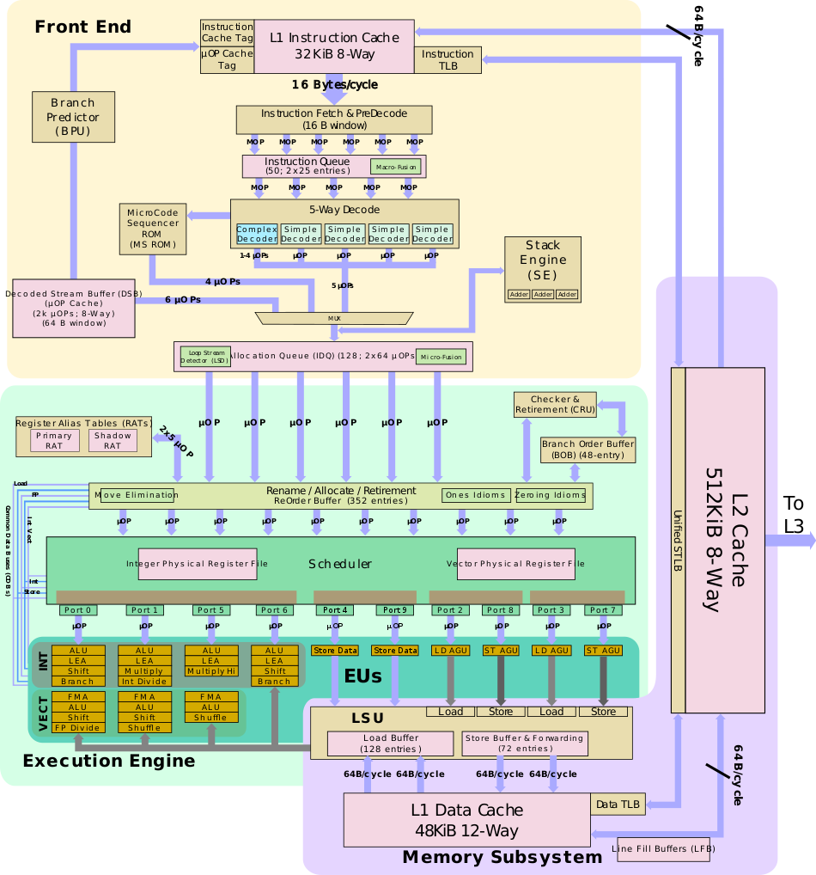
Sunny Cove
Microarchitecture
Notes:
Sunny Cove (SNC) is the successor to Palm Cove, a high-performance 10 nm x86 core microarchitecture designed by Intel for an array of server and client products, including Ice Lake (Client), Ice Lake (Server), Lakefield, and the Nervana NNP-I.
The microarchitecture was developed by Intel's R&D Center (IDC) in Haifa, Israel.

Slide 59
BPU choose next block of code.
NO
Pick it from
L1 ICache or
L2Cache or
LLC or memory.
legacy decode pipeline
Does Code Exist in Decoded ICache?
YES
Pick it from
Decoded ICache
80% hit rate for most application
Decoded ICache
1.Reducing the pipeline length and lower miss penalty
during branch miss prediction.
2.Increases the μOp bandwidth to out-of-order engine
3.Allows reducing power consumption in the front-end
Notes:
The pipeline can be broken down into three areas: the front-end, back-end or execution engine, and the memory subsystem. The goal of the front-end is to feed the back-end with a sufficient stream of operations which it gets by decoding instructions coming from memory. The front-end has two major pathways: the µOPs cache path and the legacy path. The legacy path is the traditional path whereby variable-length x86 instructions are fetched from the level 1 instruction cache, queued, and consequently get decoded into simpler, fixed-length µOPs. The alternative and much more desired path is the µOPs cache path whereby a cache containing already decoded µOPs receives a hit allowing the µOPs to be sent directly to the decode queue.
Regardless of which path an instruction ends up taking it will eventually arrive at the decode queue. The IDQ represents the end of the front-end and the in-order part of the machine and the start of the execution engine which operates out-of-order.
In other words, the front end needs to be able to consistently deliver enough µOPs from the instruction code stream to keep the back-end busy.
When the back-end is not being fully utilized, the core is not reaching its full performance. A poorly or under-performing front-end will translate directly to a poorly performing core.
The flow of an instruction in the pipeline can be summarized in the following progression:
1. The Branch Prediction Unit chooses the next block of code to execute from the program. The
processor searches for the code in the following resources, in this order:
a. Decoded ICache.
b. Instruction Cache, via activating the legacy decode pipeline.
c. L2 cache, last level cache (LLC) and memory, as necessary.
2. The micro-ops corresponding to this code are sent to the Rename/retirement block. They enter into
the scheduler in program order, but execute and are de-allocated from the scheduler according to
data-flow order. For simultaneously ready micro-ops, FIFO ordering is nearly always maintained.
Micro-op execution is executed using execution resources arranged in three stacks. The execution
units in each stack are associated with the data type of the instruction.
Branch mispredictions are signaled at branch execution. It re-steers the front end which delivers
micro-ops from the correct path. The processor can overlap work preceding the branch misprediction
with work from the following corrected path.
3. Memory operations are managed and reordered to achieve parallelism and maximum performance.
Misses to the L1 data cache go to the L2 cache. The data cache is non-blocking and can handle
multiple simultaneous misses.
4. Exceptions (Faults, Traps) are signaled at retirement (or attempted retirement) of the faulting
instruction.
https://en.wikichip.org/wiki/intel/microarchitectures/skylake_(client)
https://stackoverflow.com/questions/33026830/difference-between-an-instruction-and-a-micro-op
Legacy Decode Pipeline
The Legacy Decode Pipeline comprises the instruction translation lookaside buffer (ITLB), the instruction
cache (ICache), instruction predecode, and instruction decode units.
Fetch & pre-decoding
On their first pass, instructions should have already been prefetched from the L2 cache and into the L1 cache. The L1 is a 32 KiB, 8-way set associative cache, identical in size and organization to previous generations. Skylake fetching is done on a 16-byte fetch window. A window size that has not changed in a number of generations. Up to 16 bytes of code can be fetched each cycle. Note that fetcher is shared evenly between the two threads so that each thread gets every other cycle. At this point they are still macro-ops (i.e. variable-length x86 architectural instruction). Instructions are brought into the pre-decode buffer for initial preparation.
An instruction fetch is a 16-byte aligned lookup through the ITLB and into the instruction cache. The instruction cache can deliver every cycle 16 bytes to the instruction pre-decoder.
Upon ITLB miss there is a lookup to the Second level TLB (STLB) that is common to the DTLB and the
ITLB. The penalty of an ITLB miss and a STLB hit is seven cycles.
Instruction PreDecode
The predecode unit accepts the 16 bytes from the instruction cache and determines the length of the instructions.
x86 instructions are complex, variable length, have inconsistent encoding, and may contain multiple operations. At the pre-decode buffer, the instructions boundaries get detected and marked.
because each instruction can vary from a single byte all the way up to fifteen.
Moreover, determining the length requires inspecting a couple of bytes of the instruction. In addition to boundary marking, prefixes are also decoded and checked for various properties such as branches.
As with previous microarchitectures, the pre-decoder has a throughput of 6 macro-ops per cycle or until all 16 bytes are consumed, whichever happens first.
Note that the predecoder will not load a new 16-byte block until the previous block has been fully exhausted. For example, suppose a new chunk was loaded, resulting in 7 instructions. In the first cycle, 6 instructions will be processed and a whole second cycle will be wasted for that last instruction. This will produce the much lower throughput of 3.5 instructions per cycle which is considerably less than optimal. Likewise, if the 16-byte block resulted in just 4 instructions with 1 byte of the 5th instruction received, the first 4 instructions will be processed in the first cycle and a second cycle will be required for the last instruction. This will produce an average throughput of 2.5 instructions per cycle.
Note that there is a special case for length-changing prefix (LCPs) which will incur additional pre-decoding costs. Real code is often less than 4 bytes which usually results in a good rate.
Instruction Queue & MOP-Fusion
The pre-decoded instructions are delivered to the Instruction Queue (IQ). In Broadwell, the Instruction Queue has been increased to 25 entries duplicated over for each thread (i.e. 50 total entries).
One key optimization the instruction queue does is macro-op fusion. Skylake can fuse two macro-ops into a single complex one in a number of cases.
In cases where a test or compare instruction with a subsequent conditional jump is detected, it will be converted into a single compare-and-branch instruction. Those fused instructions remain fused throughout the entire pipeline and get executed as a single operation by the branch unit thereby saving bandwidth everywhere. Only one such fusion can be performed during each cycle.
MOP-Fusion Example:
cmp eax, [mem]
jne loop →cmpjne eax, [mem], loop

Slide 60
Front-End :Fetch & pre-decoding
In-order execution
Fetch instruction from L2, LLC or Memory into L1 cache
Fetch instruction from L1 ICache into pre-decode buffer in 16 B window / cycle.
fetcher is shared evenly between the two threads so that each thread gets every other cycle
Pre-decoding : x86 instructions are complex, variable length, have inconsistent encoding, and may contain multiple operations.
1 Determine instruction length.
2 Decoding prefixes. (LCP,).
3 Mark various properties of instruction for decoders.
For example , “is branches” for help second phase decoding.
the pre-decoder has a throughput of 6 macro-ops per cycle or until all 16 bytes are consumed.
If 16 byte result 7 instruction, 6 instruction will be processed in first cycle and 1 instruction in second cycle.
a whole second cycle will be wasted for that last instruction and result 3.5 instruction per cycle.
Instructions in this phase are macro-operation or assembly operation.
Each macro instruction consist of sequence of micro-operation.
Micro-ops are basic operations on data stored in one or more registers, including transferring data between registers or between registers and external buses of the central processing unit (CPU), and performing arithmetic or logical operations on registers
Notes:
Legacy Decode Pipeline
The Legacy Decode Pipeline comprises the instruction translation lookaside buffer (ITLB), the instruction
cache (ICache), instruction predecode, and instruction decode units.
Fetch & pre-decoding
On their first pass, instructions should have already been prefetched from the L2 cache and into the L1 cache. The L1 is a 32 KiB, 8-way set associative cache, identical in size and organization to previous generations. Skylake fetching is done on a 16-byte fetch window. A window size that has not changed in a number of generations. Up to 16 bytes of code can be fetched each cycle. Note that fetcher is shared evenly between the two threads so that each thread gets every other cycle. At this point they are still macro-ops (i.e. variable-length x86 architectural instruction). Instructions are brought into the pre-decode buffer for initial preparation.
An instruction fetch is a 16-byte aligned lookup through the ITLB and into the instruction cache. The instruction cache can deliver every cycle 16 bytes to the instruction pre-decoder.
Upon ITLB miss there is a lookup to the Second level TLB (STLB) that is common to the DTLB and the
ITLB. The penalty of an ITLB miss and a STLB hit is seven cycles.
Instruction PreDecode
The predecode unit accepts the 16 bytes from the instruction cache and determines the length of the instructions.
x86 instructions are complex, variable length, have inconsistent encoding, and may contain multiple operations. At the pre-decode buffer, the instructions boundaries get detected and marked.
because each instruction can vary from a single byte all the way up to fifteen.
Moreover, determining the length requires inspecting a couple of bytes of the instruction. In addition to boundary marking, prefixes are also decoded and checked for various properties such as branches.
As with previous microarchitectures, the pre-decoder has a throughput of 6 macro-ops per cycle or until all 16 bytes are consumed, whichever happens first.
Note that the predecoder will not load a new 16-byte block until the previous block has been fully exhausted. For example, suppose a new chunk was loaded, resulting in 7 instructions. In the first cycle, 6 instructions will be processed and a whole second cycle will be wasted for that last instruction. This will produce the much lower throughput of 3.5 instructions per cycle which is considerably less than optimal. Likewise, if the 16-byte block resulted in just 4 instructions with 1 byte of the 5th instruction received, the first 4 instructions will be processed in the first cycle and a second cycle will be required for the last instruction. This will produce an average throughput of 2.5 instructions per cycle.
Note that there is a special case for length-changing prefix (LCPs) which will incur additional pre-decoding costs. Real code is often less than 4 bytes which usually results in a good rate.
Instruction Queue & MOP-Fusion
The pre-decoded instructions are delivered to the Instruction Queue (IQ). In Broadwell, the Instruction Queue has been increased to 25 entries duplicated over for each thread (i.e. 50 total entries).
One key optimization the instruction queue does is macro-op fusion. Skylake can fuse two macro-ops into a single complex one in a number of cases.
In cases where a test or compare instruction with a subsequent conditional jump is detected, it will be converted into a single compare-and-branch instruction. Those fused instructions remain fused throughout the entire pipeline and get executed as a single operation by the branch unit thereby saving bandwidth everywhere. Only one such fusion can be performed during each cycle.
MOP-Fusion Example:
cmp eax, [mem]
jne loop →cmpjne eax, [mem], loop

Slide 61
Front-End : Instruction Queue (IQ)
In-order execution
The pre-decoded instructions are delivered to the IQ It has 25 entries for each thread
One key optimization the IQ does is macro-op fusion
macro-ops fusion is to combine multiple adjacent
instructions into a single instruction.
macro-ops fusion reduce the number of instructions that must be executed so more works can be done with fewer resources.
cmp eax,[mem]
jne loop
fuse
cmpjne eax,[mem],loop
fused instructions can represent more work with fewer bits, free up execution units, tracking information (e.g. in the rename unit), save pipeline bandwidth in all stages from decode to retire, and consequently save power.
fused instructions remain fused throughout the entire pipeline and get executed as a single operation
Only one such fusion can be performed during each cycle. Those instructions are later decoded into fused-µOPs.
Notes:
Instruction Queue & MOP-Fusion
The pre-decoded instructions are delivered to the Instruction Queue (IQ). In Broadwell, the Instruction Queue has been increased to 25 entries duplicated over for each thread (i.e. 50 total entries).
One key optimization the instruction queue does is macro-op fusion. Skylake can fuse two macro-ops into a single complex one in a number of cases.
In cases where a test or compare instruction with a subsequent conditional jump is detected, it will be converted into a single compare-and-branch instruction. Those fused instructions remain fused throughout the entire pipeline and get executed as a single operation by the branch unit thereby saving bandwidth everywhere. Only one such fusion can be performed during each cycle.
MOP-Fusion Example:
cmp eax, [mem]
jne loop →cmpjne eax, [mem], loop
Additionally, only up to 1 macrofusion can take place each cycle. If there it's possible to perform 2 macrofusions, only the first pair will be fused. The second pair will continue unfused.
One of the three performance knobs of a microprocessor is the instruction count. By reducing the number of instructions that must be executed, more work can be done with fewer resources. The idea behind macro-operation fusion is to combine multiple adjacent instructions into a single instruction. A fused instruction typically remains fused throughout its lifetime. Therefore fused instructions can represent more work with fewer bits, free up execution units, tracking information (e.g. in the rename unit), save pipeline bandwidth in all stages from decode to retire, and consequently save power.

Slide 62
Front-End : Decoder
In-order execution
Decoders read in macro-ops and emit regular, fixed length µOPs.
Front-End : MS-ROM
In-order execution
The five decoders are asymmetric; the first one, Decoder 0, is a complex decoder while the other four are simple decoders.
simple decoders can handle instruction which are translated to a single µOP
There are some x86 instructions, such as string instructions, that require more than four μops..
complex decoder can handle instruction which are can be translated up to 4 µOP
These instruction are not trivial to be decoded even by complex decoder.
Some x86 instruction that have memory operand or use complex addressing modes are translated to more than one µOP
These instruction send to MS-Rom for decoding.
When that happens, up to 4 µOPs/cycle are emitted until the microcode sequencer is generate all μops .
During that time, the decoders are disabled.
Micro-ops emitted by the decoders are directed to the micro-op queue and to the Decoded µOP Cache.
Notes:
The pipeline can be broken down into three areas: the front-end, back-end or execution engine, and the memory subsystem. The goal of the front-end is to feed the back-end with a sufficient stream of operations which it gets by decoding instructions coming from memory. The front-end has two major pathways: the µOPs cache path and the legacy path. The legacy path is the traditional path whereby variable-length x86 instructions are fetched from the level 1 instruction cache, queued, and consequently get decoded into simpler, fixed-length µOPs. The alternative and much more desired path is the µOPs cache path whereby a cache containing already decoded µOPs receives a hit allowing the µOPs to be sent directly to the decode queue.
Regardless of which path an instruction ends up taking it will eventually arrive at the decode queue. The IDQ represents the end of the front-end and the in-order part of the machine and the start of the execution engine which operates out-of-order.
In other words, the front end needs to be able to consistently deliver enough µOPs from the instruction code stream to keep the back-end busy.
When the back-end is not being fully utilized, the core is not reaching its full performance. A poorly or under-performing front-end will translate directly to a poorly performing core.
The flow of an instruction in the pipeline can be summarized in the following progression:
1. The Branch Prediction Unit chooses the next block of code to execute from the program. The
processor searches for the code in the following resources, in this order:
a. Decoded ICache.
b. Instruction Cache, via activating the legacy decode pipeline.
c. L2 cache, last level cache (LLC) and memory, as necessary.
2. The micro-ops corresponding to this code are sent to the Rename/retirement block. They enter into
the scheduler in program order, but execute and are de-allocated from the scheduler according to
data-flow order. For simultaneously ready micro-ops, FIFO ordering is nearly always maintained.
Micro-op execution is executed using execution resources arranged in three stacks. The execution
units in each stack are associated with the data type of the instruction.
Branch mispredictions are signaled at branch execution. It re-steers the front end which delivers
micro-ops from the correct path. The processor can overlap work preceding the branch misprediction
with work from the following corrected path.
3. Memory operations are managed and reordered to achieve parallelism and maximum performance.
Misses to the L1 data cache go to the L2 cache. The data cache is non-blocking and can handle
multiple simultaneous misses.
4. Exceptions (Faults, Traps) are signaled at retirement (or attempted retirement) of the faulting
instruction.
https://en.wikichip.org/wiki/intel/microarchitectures/skylake_(client)
https://stackoverflow.com/questions/33026830/difference-between-an-instruction-and-a-micro-op
Legacy Decode Pipeline
The Legacy Decode Pipeline comprises the instruction translation lookaside buffer (ITLB), the instruction
cache (ICache), instruction predecode, and instruction decode units.
Fetch & pre-decoding
On their first pass, instructions should have already been prefetched from the L2 cache and into the L1 cache. The L1 is a 32 KiB, 8-way set associative cache, identical in size and organization to previous generations. Skylake fetching is done on a 16-byte fetch window. A window size that has not changed in a number of generations. Up to 16 bytes of code can be fetched each cycle. Note that fetcher is shared evenly between the two threads so that each thread gets every other cycle. At this point they are still macro-ops (i.e. variable-length x86 architectural instruction). Instructions are brought into the pre-decode buffer for initial preparation.
An instruction fetch is a 16-byte aligned lookup through the ITLB and into the instruction cache. The instruction cache can deliver every cycle 16 bytes to the instruction pre-decoder.
Upon ITLB miss there is a lookup to the Second level TLB (STLB) that is common to the DTLB and the
ITLB. The penalty of an ITLB miss and a STLB hit is seven cycles.
Instruction PreDecode
The predecode unit accepts the 16 bytes from the instruction cache and determines the length of the instructions.
x86 instructions are complex, variable length, have inconsistent encoding, and may contain multiple operations. At the pre-decode buffer, the instructions boundaries get detected and marked.
because each instruction can vary from a single byte all the way up to fifteen.
Moreover, determining the length requires inspecting a couple of bytes of the instruction. In addition to boundary marking, prefixes are also decoded and checked for various properties such as branches.
As with previous microarchitectures, the pre-decoder has a throughput of 6 macro-ops per cycle or until all 16 bytes are consumed, whichever happens first.
Note that the predecoder will not load a new 16-byte block until the previous block has been fully exhausted. For example, suppose a new chunk was loaded, resulting in 7 instructions. In the first cycle, 6 instructions will be processed and a whole second cycle will be wasted for that last instruction. This will produce the much lower throughput of 3.5 instructions per cycle which is considerably less than optimal. Likewise, if the 16-byte block resulted in just 4 instructions with 1 byte of the 5th instruction received, the first 4 instructions will be processed in the first cycle and a second cycle will be required for the last instruction. This will produce an average throughput of 2.5 instructions per cycle.
Note that there is a special case for length-changing prefix (LCPs) which will incur additional pre-decoding costs. Real code is often less than 4 bytes which usually results in a good rate.
Instruction Queue & MOP-Fusion
The pre-decoded instructions are delivered to the Instruction Queue (IQ). In Broadwell, the Instruction Queue has been increased to 25 entries duplicated over for each thread (i.e. 50 total entries).
One key optimization the instruction queue does is macro-op fusion. Skylake can fuse two macro-ops into a single complex one in a number of cases.
In cases where a test or compare instruction with a subsequent conditional jump is detected, it will be converted into a single compare-and-branch instruction. Those fused instructions remain fused throughout the entire pipeline and get executed as a single operation by the branch unit thereby saving bandwidth everywhere. Only one such fusion can be performed during each cycle.
MOP-Fusion Example:
cmp eax, [mem]
jne loop →cmpjne eax, [mem], loop

Slide 63
Front-End :
Stack Engine
In-order execution
The Stack Engine sits after the decoders and monitors the µOPs stream, Incoming stack-modifying operations are caught by the Stack Engine.
Instructions such as PUSH, POP, as well as CALL, and RET all operate on the stack pointer (ESP).
The Stack Engine has a set of three dedicated adders it uses to perform and eliminate the stack-updating µOPs
Without StackEngine this operation would send to general purpose ALU, so SE leads to save µOPs bandwidths, reduce scheduler and execution units load.
Notes:
The pipeline can be broken down into three areas: the front-end, back-end or execution engine, and the memory subsystem. The goal of the front-end is to feed the back-end with a sufficient stream of operations which it gets by decoding instructions coming from memory. The front-end has two major pathways: the µOPs cache path and the legacy path. The legacy path is the traditional path whereby variable-length x86 instructions are fetched from the level 1 instruction cache, queued, and consequently get decoded into simpler, fixed-length µOPs. The alternative and much more desired path is the µOPs cache path whereby a cache containing already decoded µOPs receives a hit allowing the µOPs to be sent directly to the decode queue.
Regardless of which path an instruction ends up taking it will eventually arrive at the decode queue. The IDQ represents the end of the front-end and the in-order part of the machine and the start of the execution engine which operates out-of-order.
In other words, the front end needs to be able to consistently deliver enough µOPs from the instruction code stream to keep the back-end busy.
When the back-end is not being fully utilized, the core is not reaching its full performance. A poorly or under-performing front-end will translate directly to a poorly performing core.
The flow of an instruction in the pipeline can be summarized in the following progression:
1. The Branch Prediction Unit chooses the next block of code to execute from the program. The
processor searches for the code in the following resources, in this order:
a. Decoded ICache.
b. Instruction Cache, via activating the legacy decode pipeline.
c. L2 cache, last level cache (LLC) and memory, as necessary.
2. The micro-ops corresponding to this code are sent to the Rename/retirement block. They enter into
the scheduler in program order, but execute and are de-allocated from the scheduler according to
data-flow order. For simultaneously ready micro-ops, FIFO ordering is nearly always maintained.
Micro-op execution is executed using execution resources arranged in three stacks. The execution
units in each stack are associated with the data type of the instruction.
Branch mispredictions are signaled at branch execution. It re-steers the front end which delivers
micro-ops from the correct path. The processor can overlap work preceding the branch misprediction
with work from the following corrected path.
3. Memory operations are managed and reordered to achieve parallelism and maximum performance.
Misses to the L1 data cache go to the L2 cache. The data cache is non-blocking and can handle
multiple simultaneous misses.
4. Exceptions (Faults, Traps) are signaled at retirement (or attempted retirement) of the faulting
instruction.
https://en.wikichip.org/wiki/intel/microarchitectures/skylake_(client)
https://stackoverflow.com/questions/33026830/difference-between-an-instruction-and-a-micro-op
Legacy Decode Pipeline
The Legacy Decode Pipeline comprises the instruction translation lookaside buffer (ITLB), the instruction
cache (ICache), instruction predecode, and instruction decode units.
Fetch & pre-decoding
On their first pass, instructions should have already been prefetched from the L2 cache and into the L1 cache. The L1 is a 32 KiB, 8-way set associative cache, identical in size and organization to previous generations. Skylake fetching is done on a 16-byte fetch window. A window size that has not changed in a number of generations. Up to 16 bytes of code can be fetched each cycle. Note that fetcher is shared evenly between the two threads so that each thread gets every other cycle. At this point they are still macro-ops (i.e. variable-length x86 architectural instruction). Instructions are brought into the pre-decode buffer for initial preparation.
An instruction fetch is a 16-byte aligned lookup through the ITLB and into the instruction cache. The instruction cache can deliver every cycle 16 bytes to the instruction pre-decoder.
Upon ITLB miss there is a lookup to the Second level TLB (STLB) that is common to the DTLB and the
ITLB. The penalty of an ITLB miss and a STLB hit is seven cycles.
Instruction PreDecode
The predecode unit accepts the 16 bytes from the instruction cache and determines the length of the instructions.
x86 instructions are complex, variable length, have inconsistent encoding, and may contain multiple operations. At the pre-decode buffer, the instructions boundaries get detected and marked.
because each instruction can vary from a single byte all the way up to fifteen.
Moreover, determining the length requires inspecting a couple of bytes of the instruction. In addition to boundary marking, prefixes are also decoded and checked for various properties such as branches.
As with previous microarchitectures, the pre-decoder has a throughput of 6 macro-ops per cycle or until all 16 bytes are consumed, whichever happens first.
Note that the predecoder will not load a new 16-byte block until the previous block has been fully exhausted. For example, suppose a new chunk was loaded, resulting in 7 instructions. In the first cycle, 6 instructions will be processed and a whole second cycle will be wasted for that last instruction. This will produce the much lower throughput of 3.5 instructions per cycle which is considerably less than optimal. Likewise, if the 16-byte block resulted in just 4 instructions with 1 byte of the 5th instruction received, the first 4 instructions will be processed in the first cycle and a second cycle will be required for the last instruction. This will produce an average throughput of 2.5 instructions per cycle.
Note that there is a special case for length-changing prefix (LCPs) which will incur additional pre-decoding costs. Real code is often less than 4 bytes which usually results in a good rate.
Instruction Queue & MOP-Fusion
The pre-decoded instructions are delivered to the Instruction Queue (IQ). In Broadwell, the Instruction Queue has been increased to 25 entries duplicated over for each thread (i.e. 50 total entries).
One key optimization the instruction queue does is macro-op fusion. Skylake can fuse two macro-ops into a single complex one in a number of cases.
In cases where a test or compare instruction with a subsequent conditional jump is detected, it will be converted into a single compare-and-branch instruction. Those fused instructions remain fused throughout the entire pipeline and get executed as a single operation by the branch unit thereby saving bandwidth everywhere. Only one such fusion can be performed during each cycle.
MOP-Fusion Example:
cmp eax, [mem]
jne loop →cmpjne eax, [mem], loop

Slide 64
Front-End :
Allocation Queue /
Instruction Decode Queue
In-Order to Out-OF-Order
Front-End
The emitted µOPs from the decoders are sent directly to the Allocation Queue
Execution Unit
The Allocation Queue acts as the interface between the front-end (in-order) and the back-end (out-of-order).
it's partitioned between two threads.
help absorb bubbles which may be introduced in the front-end which produce due to :
Bad speculation.
CPU stalls
Data dependencies.
Loop Stream Detector (LSD)
The LSD detects small loops that fit in the micro-op queue and locks them down.
The loop streams from the micro-op queue, with no more fetching, decoding, or reading micro-ops from any of the caches, until a branch mis-prediction inevitably ends it.
while the LSD is active, the rest of the front-end is effectively disabled.
The loops with the following attributes qualify for LSD/micro-op queue replay:
• Up to eight chunk fetches of 32-instruction-bytes.
• Up to 28 micro-ops (~28 instructions).
• All micro-ops are also resident in the Decoded ICache.
• Can contain no more than eight taken branches and none of them can be a CALL or RET.
• Cannot have mismatched stack operations. For example, more PUSH than POP instructions.
For high performance code, loop unrolling is generally preferable for performance even when it overflows the LSD capability
Notes:
The pipeline can be broken down into three areas: the front-end, back-end or execution engine, and the memory subsystem. The goal of the front-end is to feed the back-end with a sufficient stream of operations which it gets by decoding instructions coming from memory. The front-end has two major pathways: the µOPs cache path and the legacy path. The legacy path is the traditional path whereby variable-length x86 instructions are fetched from the level 1 instruction cache, queued, and consequently get decoded into simpler, fixed-length µOPs. The alternative and much more desired path is the µOPs cache path whereby a cache containing already decoded µOPs receives a hit allowing the µOPs to be sent directly to the decode queue.
Regardless of which path an instruction ends up taking it will eventually arrive at the decode queue. The IDQ represents the end of the front-end and the in-order part of the machine and the start of the execution engine which operates out-of-order.
In other words, the front end needs to be able to consistently deliver enough µOPs from the instruction code stream to keep the back-end busy.
When the back-end is not being fully utilized, the core is not reaching its full performance. A poorly or under-performing front-end will translate directly to a poorly performing core.
The flow of an instruction in the pipeline can be summarized in the following progression:
1. The Branch Prediction Unit chooses the next block of code to execute from the program. The
processor searches for the code in the following resources, in this order:
a. Decoded ICache.
b. Instruction Cache, via activating the legacy decode pipeline.
c. L2 cache, last level cache (LLC) and memory, as necessary.
2. The micro-ops corresponding to this code are sent to the Rename/retirement block. They enter into
the scheduler in program order, but execute and are de-allocated from the scheduler according to
data-flow order. For simultaneously ready micro-ops, FIFO ordering is nearly always maintained.
Micro-op execution is executed using execution resources arranged in three stacks. The execution
units in each stack are associated with the data type of the instruction.
Branch mispredictions are signaled at branch execution. It re-steers the front end which delivers
micro-ops from the correct path. The processor can overlap work preceding the branch misprediction
with work from the following corrected path.
3. Memory operations are managed and reordered to achieve parallelism and maximum performance.
Misses to the L1 data cache go to the L2 cache. The data cache is non-blocking and can handle
multiple simultaneous misses.
4. Exceptions (Faults, Traps) are signaled at retirement (or attempted retirement) of the faulting
instruction.
https://en.wikichip.org/wiki/intel/microarchitectures/skylake_(client)
https://stackoverflow.com/questions/33026830/difference-between-an-instruction-and-a-micro-op
Legacy Decode Pipeline
The Legacy Decode Pipeline comprises the instruction translation lookaside buffer (ITLB), the instruction
cache (ICache), instruction predecode, and instruction decode units.
Fetch & pre-decoding
On their first pass, instructions should have already been prefetched from the L2 cache and into the L1 cache. The L1 is a 32 KiB, 8-way set associative cache, identical in size and organization to previous generations. Skylake fetching is done on a 16-byte fetch window. A window size that has not changed in a number of generations. Up to 16 bytes of code can be fetched each cycle. Note that fetcher is shared evenly between the two threads so that each thread gets every other cycle. At this point they are still macro-ops (i.e. variable-length x86 architectural instruction). Instructions are brought into the pre-decode buffer for initial preparation.
An instruction fetch is a 16-byte aligned lookup through the ITLB and into the instruction cache. The instruction cache can deliver every cycle 16 bytes to the instruction pre-decoder.
Upon ITLB miss there is a lookup to the Second level TLB (STLB) that is common to the DTLB and the
ITLB. The penalty of an ITLB miss and a STLB hit is seven cycles.
Instruction PreDecode
The predecode unit accepts the 16 bytes from the instruction cache and determines the length of the instructions.
x86 instructions are complex, variable length, have inconsistent encoding, and may contain multiple operations. At the pre-decode buffer, the instructions boundaries get detected and marked.
because each instruction can vary from a single byte all the way up to fifteen.
Moreover, determining the length requires inspecting a couple of bytes of the instruction. In addition to boundary marking, prefixes are also decoded and checked for various properties such as branches.
As with previous microarchitectures, the pre-decoder has a throughput of 6 macro-ops per cycle or until all 16 bytes are consumed, whichever happens first.
Note that the predecoder will not load a new 16-byte block until the previous block has been fully exhausted. For example, suppose a new chunk was loaded, resulting in 7 instructions. In the first cycle, 6 instructions will be processed and a whole second cycle will be wasted for that last instruction. This will produce the much lower throughput of 3.5 instructions per cycle which is considerably less than optimal. Likewise, if the 16-byte block resulted in just 4 instructions with 1 byte of the 5th instruction received, the first 4 instructions will be processed in the first cycle and a second cycle will be required for the last instruction. This will produce an average throughput of 2.5 instructions per cycle.
Note that there is a special case for length-changing prefix (LCPs) which will incur additional pre-decoding costs. Real code is often less than 4 bytes which usually results in a good rate.
Instruction Queue & MOP-Fusion
The pre-decoded instructions are delivered to the Instruction Queue (IQ). In Broadwell, the Instruction Queue has been increased to 25 entries duplicated over for each thread (i.e. 50 total entries).
One key optimization the instruction queue does is macro-op fusion. Skylake can fuse two macro-ops into a single complex one in a number of cases.
In cases where a test or compare instruction with a subsequent conditional jump is detected, it will be converted into a single compare-and-branch instruction. Those fused instructions remain fused throughout the entire pipeline and get executed as a single operation by the branch unit thereby saving bandwidth everywhere. Only one such fusion can be performed during each cycle.
MOP-Fusion Example:
cmp eax, [mem]
jne loop →cmpjne eax, [mem], loop

Slide 65
Front-End :
Micro-Fusion
Micro-fusion fuses multiple micro-ops from the same instruction into a single complex micro-op(RISC to CISC translation) .
Front-End
Micro-fusion improves instruction bandwidth delivered from decode to retirement and saves power.
Execution Unit
LD R5,(R4)
ADD R3,R5
ADD R3,(R4)
Notes:
In the back-end, the micro-operations visit the reorder buffer. It's there where register allocation, renaming, and retiring takes place. At this stage a number of other optimizations are also done. From the reorder buffer, µOPs are sent to the unified scheduler. The scheduler has a number of exit ports, each wired to a set of different execution units. Some units can perform basic ALU operations, others can do multiplication and division, with some units capable of more complex operations such as various vector operations. The scheduler is effectively in charge of queuing the µOPs on the appropriate port so they can be executed by the appropriate unit.
Some µOPs deal with memory access (e.g. load & store). Those will be sent on dedicated scheduler ports that can perform those memory operations. Store operations go to the store buffer which is also capable of performing forwarding when needed. Likewise, Load operations come from the load buffer. Sunny Cove features a dedicated 48 KiB level 1 data cache and a dedicated 32 KiB level 1 instruction cache. It also features a core-private 512 KiB L2 cache that is shared by both of the L1 caches.
Each core enjoys a slice of a third level of cache that is shared by all the core. For Ice Lake (Client) which incorporates Sunny Cove cores, there are either two cores or four cores connected together on a single chip.

